Slide 1
Moral Injury Among Correctional Mental Health Staff: Definitions, Considerations, & Recommendations
Dr. Stephanie Gangemi
PhD, LCSW
NCCHC
Mental Health Conference
Summer 2022

Slide 2
Disclosures & Disclaimers
I do not have any relevant financial relationships with any commercial interests.
This informational presentation was developed by independent experts. The information provided in this presentation is not the official position or recommendation of NCCHC, but rather expert opinion. This information is not intended to be appropriate for every clinical situation nor does it replace clinical judgement.
NCCHC does not endorse or recommend any products or services mentioned.

Slide 3
Learning Objectives
1-Define the concept of moral injury and identify key constructs and how they are present in correctional environments.
2 – Explore the experience of moral injury in correctional environments and how moral injury may be experienced by correctional mental health staff.
3 – Identify opportunities to address and mitigate the harmful effects of moral injury in correctional environments.

Slide 4
Agenda
Introduction
Research
Moral Injury Definitions
Moral Injury in Corrections
Small Group Conversations
Study Findings
Mitigating MI
Areas for Future Research
Resources
Q&A
Wrap Up

Slide 5
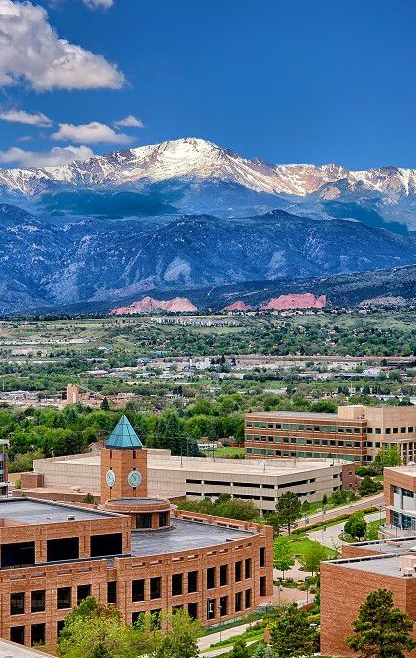
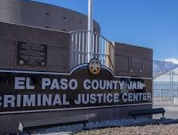
Introduction
Thank you for being here!
My background
Riker’s Island
El Paso County Criminal Justice Center
Caring deeply about correctional healthcare professionals
Why Moral Injury

Slide 6
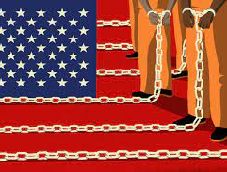
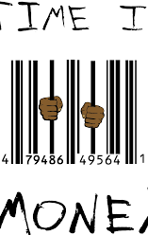
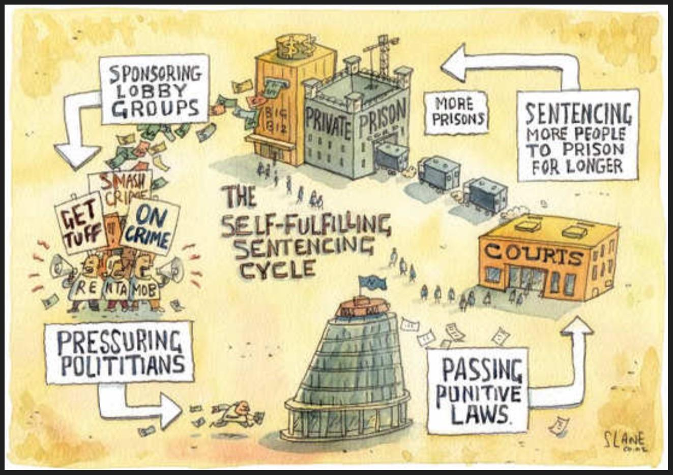
My Research
“About the Brokenness, and the Darkness, and the Light”: An Exploratory Study on the Effects of the Correctional Environment on Correctional Mental Health Professionals
Qualitative study of 22 correctional mental health professionals in Colorado
Mass incarceration in the US
Deinstitutionalization
Transinstitutionalization
Prison industrial complex
Correctional workforce

Slide 7
Theoretical Constructs
Burnout
Trauma/Secondary Trauma
Dehumanization
Moral Disengagement
Moral Injury
Corrections Fatigue
Post-traumatic growth

Slide 8
Participant Demographics

Slide 9
Interview Guide

Slide 10
Common “Culprits” – Affecting Correctional MH Professionals
“Burnout”
”Compassion Fatigue”
“Trauma”

Slide 11
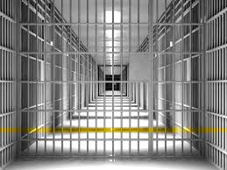
Findings: Moral Injury is a Major Factor
What is Moral Injury?
What Moral Injury is not.
What do we know about it?
What do we need to know about it?
What can we do about it?

Slide 12
What is Moral Injury?
Conceptually developed to address experiences of combat veterans
Vietnam vets, post-9/11
“Soul Wound”
1- Betrayal of what’s right
2 – By a person with legitimate authority”
3 – in a high stakes situation” (Shay, 2014)
Prescriptive-Cognition Model (Farnsworth, 2019)
Adoption of inaccurate and condemning sense of self
Stress-Injury Model (Nash, 2019)
Wound to body, brain, mind, and spirit
Application of moral injury to healthcare workers is relatively new

Slide 13
Further Definitions of Moral Injury
Moral Injury
A type of psychological trauma characterized by the experiencing of moral emotions, which can develop when one violates their moral beliefs, is betrayed, or witnesses trusted individuals committing atrocities or actions which they deem morally questionable or wrong
The expanded social, psychological, and spiritual suffering stemming from costly or unworkable attempts to manage, control, or cope with the experience of moral pain
(Farnsworth et al., 2017, Jinkerson, 2016, Ross, 2022)

Slide 14
What Moral Injury is not…
Moral injury is not PTSD
Moral injury is not burnout
Moral injury is not compassion fatigue
Moral injury is not secondary trauma
Moral injury is “outside the PTSD constellation” (Dean, et al., 2019)
About “morality not mortality”

Slide 15
Moral Injury vs. Burnout
Burnout suggests that the problem resides within the individual, who is somehow deficient...Moral injury on the other hand describes the challenge of simultaneously knowing what care patients need but being unable to provide it due to constraints that are beyond our control. (p. 401)
In correctional healthcare, Moral Injury can be seen as an inevitable consequence of a broken system riddled with double binds.
Punishment and rehabilitation
Care and control

Slide 16
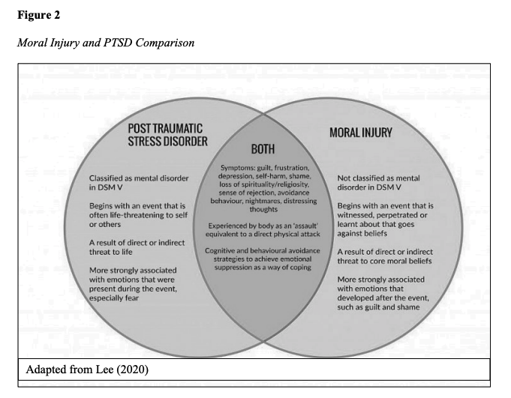
Moral Injury vs. PTSD
From Ross, B, (2022), adapted from Lee, P (2020)

Slide 17
Moral Disengagement in Corrections
Other ideas about how the attitudes and behaviors of correctional mental health staff are shaped can be found in moral disengagement theory.
Bandura, 1999; Osofsky, et al., 2005; Smith, 2011; Vasiljevic & Viki, 2014 have linked moral disengagement theory with the dehumanization and poor mental health treatment of correctional clients.
Through the cognitive processes of moral disengagement, people find ways to rationalize and “justify negative behavior against particular targets.
More at the Full NCCHC conference in the Fall

Slide 18
Mechanisms Moral Disengagement - Bandura
Moral Justification
Euphemistic Labeling
Advantageous Comparison
Displacement of Responsibility
Diffusion of Responsibility
Disregard/Distortion of Consequences
Dehumanization

Slide 19
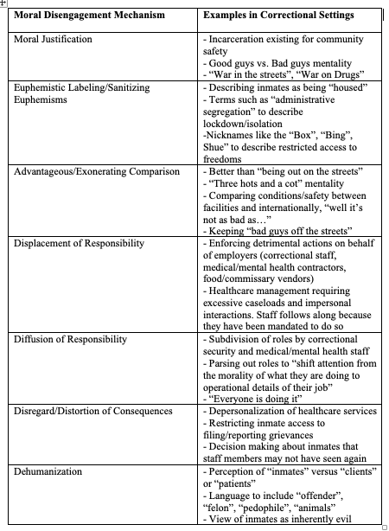
Moral Disengagement Mechanisms – Gangemi, 2021
Perhaps “burnout” is another euphemistic label for “moral injury”…

Slide 20
Video: Burnout vs. Moral Injury
Youtube Link

Slide 21
Signs of Moral Injury https://theresilienceresource.org/moral-injury/

Slide 22
Thinking About your Time in Corrections…
Did you see anything that you would consider morally wrong?
Are you ever troubled by having witnessed others’ immoral acts?
Did you have act in wants that violated your own moral code or values?
Have you ever violated your own morals by failing to do someone that you felt you should have done?
Have you ever felt betrayed by leaders who you once trusted?
How did you make sense of these events?

Slide 23
MIES
Psychometric evaluation Psychometric evaluation of the moral injury events scale –Shay, et al. (2013)

Slide 24
MI-Related Scales
MIES:Moral injury events scale
MISS-M-LF:Moral Injury Symptoms Scale-Military Long Form
EMIS-M:Expressions of Moral Injury Scale-Military version
MISS-HP:Moral Injury Symptoms Scale-Health Professional
MISS-M-SF:Moral Injury Symptoms Scale-Military Short Form
MBI-HSMP:Maslach Burnout Inventory-Human Services Survey for Medical Personnel

Slide 25
Moral Injury Symptom Scale – MISS - HP
Measures
Betrayal
Guilt
Shame
Moral Concerns
Loss of trust
Loss of meaning
Unforgiveness
Self-condemnation
Feeling punished by God
Loss of religion or faith

Slide 26
Qualitative Data : “Drinking the Kool Aid”
Participant 16: Now that I haven’t been in that environment, it’s been a year, it’s like a weight is lifted...The people who were still there, I probably see them drinking the Kool-Aid and thinking it's going to change, but yet I feel they're just stuck.
Interviewer: What was the weight?
Participant 16: I think part of it is the internal wanting to help people and feeling like you're handicapped or handcuffed. This idea that, "oh, just be patient, things will change. We're going to work it out. We’re going to make it better. We hear what you're saying." This idea that we're understood, that we’re valued, and the next administration or the next six months or the next contract or the next, whatever it is, “it'll be different, and just wait, you'll see”.
Interviewer: With these colleagues when people are "drinking the Kool-Aid", what professional behaviors do you see coming out of them?
Participant 16: How do I describe that? What can be legal may not be ethical, and I think a lot of people go into this with this idea that I want to help. They genuinely want to do the right thing. You are challenged often on a day-to-day basis between what is lawful and what is ethical and that middle ground. Granted, you give up some things and some things you say, "I would never do this," but you find yourself doing it, and you have to automatically go back to say, "Why am I doing what I’m doing and is this worth it", and what are the pros and cons?

Slide 27
Qualitative Data : “A Betrayal of What’s Right”
Participant 17: I had a captain in the Department of Corrections and he said, “acquiescence leads to acceptance, which leads to permission” and dealing with offenders. I think it also has a lot to do with us because not only are we challenged just with code of ethics and helping people doing no harm, we're challenged with offenders trying to try to manipulate us and pick up on their BS. Then also from usually the administration, the bureaucracy, the corporate governance, you get it on all sides, and very rarely is there a-- if your self-worth and your overall enjoyment is dependent upon other people within that environment, it's set up to fail.
Interviewer: Do you have any examples of those little things that you've seen that have been compromises of a person's professional work or dignity?
Participant 17:…Doing suicide rounds. The idea is to go around and check in with this person at the night, how are you doing, what's going on? You have 20 of those. You might have somebody with you, you might not. You might trust that other person, you might not. And so the idea is, hey, let's go check on each individual person. Part of the compromise is, I'm not going to go talk to 20 people. You might think I am, but this is not humanly possible. Half of them will cuss you, and then you put yourself at risk by going too close. You know you might get an F you or whatever, and that can be a quick-- whatever. It's not even worth it. For me, I'm like that's a compromise of getting my stuff done in order to complete the day and also some sense of self-care…At the same time, there's part of me, that's like I can overlook an F you, a southern vulgarity or whatever, and say 'what's really bugging you', knowing that that person might actually talk to me for a half an hour. It might not have anything to do with what the boxes I'm supposed to check for the suicide watch, but it might be extremely helpful to that person, but it had to cost me 30 minutes of my day, and who knows what all the result might be in terms of where that conversation could go, what report I might have to fill out.
I oftentimes found myself like, "Who cares?" but that's not-- You know what I’m saying? That's a compromise on my part because that's not who I am or who I ever wanted to be.

Slide 28
Qualittative Data: “Catch 22”
Participant 8: These are challenges I'm having in trying to do my job. Here's the things that I'm seeing that's making it difficult and here's how I can possibly see it making it better in addressing not only safety concerns, but also kind of the Catch 22 of HIPAA confidentiality of, I'm supposed to hold someone's intimate things as we're processing to make him better, but yet I have to report everything that's going on, and this makes it very hard for me to be a professional when that's what I was hired for and not as the correctional officer which what you're trying to implement on me. Corrections basically looked at me- having to look at my clinical work more as like an investigator on certain things which is not how we are clinically trained. We're clinically trained to be more curious and to go in as a collaborator instead of basically probation parole officer. And knowing that sometimes you have to go in with all hats on and how to juggle them while you're trying to do clinical treatment.

Slide 29
Qualitative Data: “By a Person in Power”
Participant 12:…but I had to take a week off of work…and while I was gone, some incident happened with this client and they kicked him out of the program and they were happy about it…I come back to work after a week and they're telling this story and yukking it up and so funny and he's such a liar and a manipulator and I'm sitting at my desk and I'm crying because I feel so powerless and I feel like what I'm part of as being part of this staff is corrupt. I don't want to be part of it. That's not the kind of person that I am. Worst case scenario, this guy's a liar and a manipulator, that's sad. Like, that's a bummer that he's been in this for so long and nothing's changed and how sad that this program didn't work out and they're reveling in it and so that's the kind of stuff that I mean where it's like, it’s all like there to certain people to command staff and people maybe on their level or above, it's so smiley and sweet and friendly and then that's how we treat the people who are entrusted to our care.
Interviewer: Why do you think the system worked that time (prior example) and then in another case, there's this joy about getting this person kicked out?
Participant 12: Because I didn't have to go through them because it depends on who's in power.

Slide 30
Mitigating Moral Injury for Correctional Mental Health Professionals
Further research is needed on MI in correctional healthcare professionals
1
Enhanced correctional clinical supervision
2
Resisting/rejecting “correctional complicity”
3
Increasing support for the correctional MH workforce
4

Slide 31
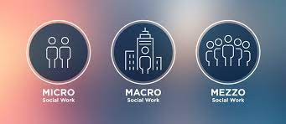
The Social Work Perspective
Social work focuses on social justice through Micro, Mezzo & Macro perspectives.
Finding solutions at each of these levels of practice
Micro - individual supports for clinicians
Mezzo – support for teams
Macro – support for the institutions of correctional healthcare

Slide 32
Components of Healing from Moral Injury
Forgiveness
Self forgiveness
Accepting responsibility
Cultivating responsibility
Making amends
Reconstructing intact moral identity
Guilt and Shame Reduction
Have any of you worked on self-forgiveness before?
What has helped?
What hindered that process? Roadblocks?
What surprised you?
https://www.inc.com/rhett-power/master-self-forgiveness-with-these-5-questions.html

Slide 33
Moral Injury Resources
The Shay Moral Injury Center: https://www.voa.org/moral-injury-war-inside?gclid=Cj0KCQjwio6XBhCMARIsAC0u9aFgYuqbfx94JaHEWj-H_oV-KvWA89OzCB0GMG9Y8f3Yu-uMnxJztlYaAmaMEALw_wcB
Treating Moral Injuries: https://www.scientificamerican.com/article/treating-moral-injuries/
Moral Injury: https://www.ptsd.va.gov/professional/treat/cooccurring/moral_injury.asp
Book: Moral Distress and Injury in Human Services:Cases, Causes, and Strategies for Prevention – Reamer, F
https://www.voa.org/social-work-community-advocates
NAADAC PPT: https://www.naadac.org/assets/2416/cardwell_nuckols_treatingmoral.pdf

Slide 34
Directions for Future Research
Mixed methods study using the Moral Injury Events Scale (MIES) in conjunction with qualitative interviews
Examining prevalence of MI among correctional healthcare workers
Implementation and analysis of Correctional Mental Health Supervision Framework to address MI

Slide 35
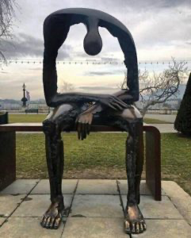
Implications for Practice
Combatting inhumanities of the CJS
Renegotiate the “dual mandate” of punishment and rehabilitation
Rethinking ”correctional complicity”
Supporting the correctional mental health workforce
Enhancing correctional clinical supervision
Sculpture - Melancolie

Slide 36
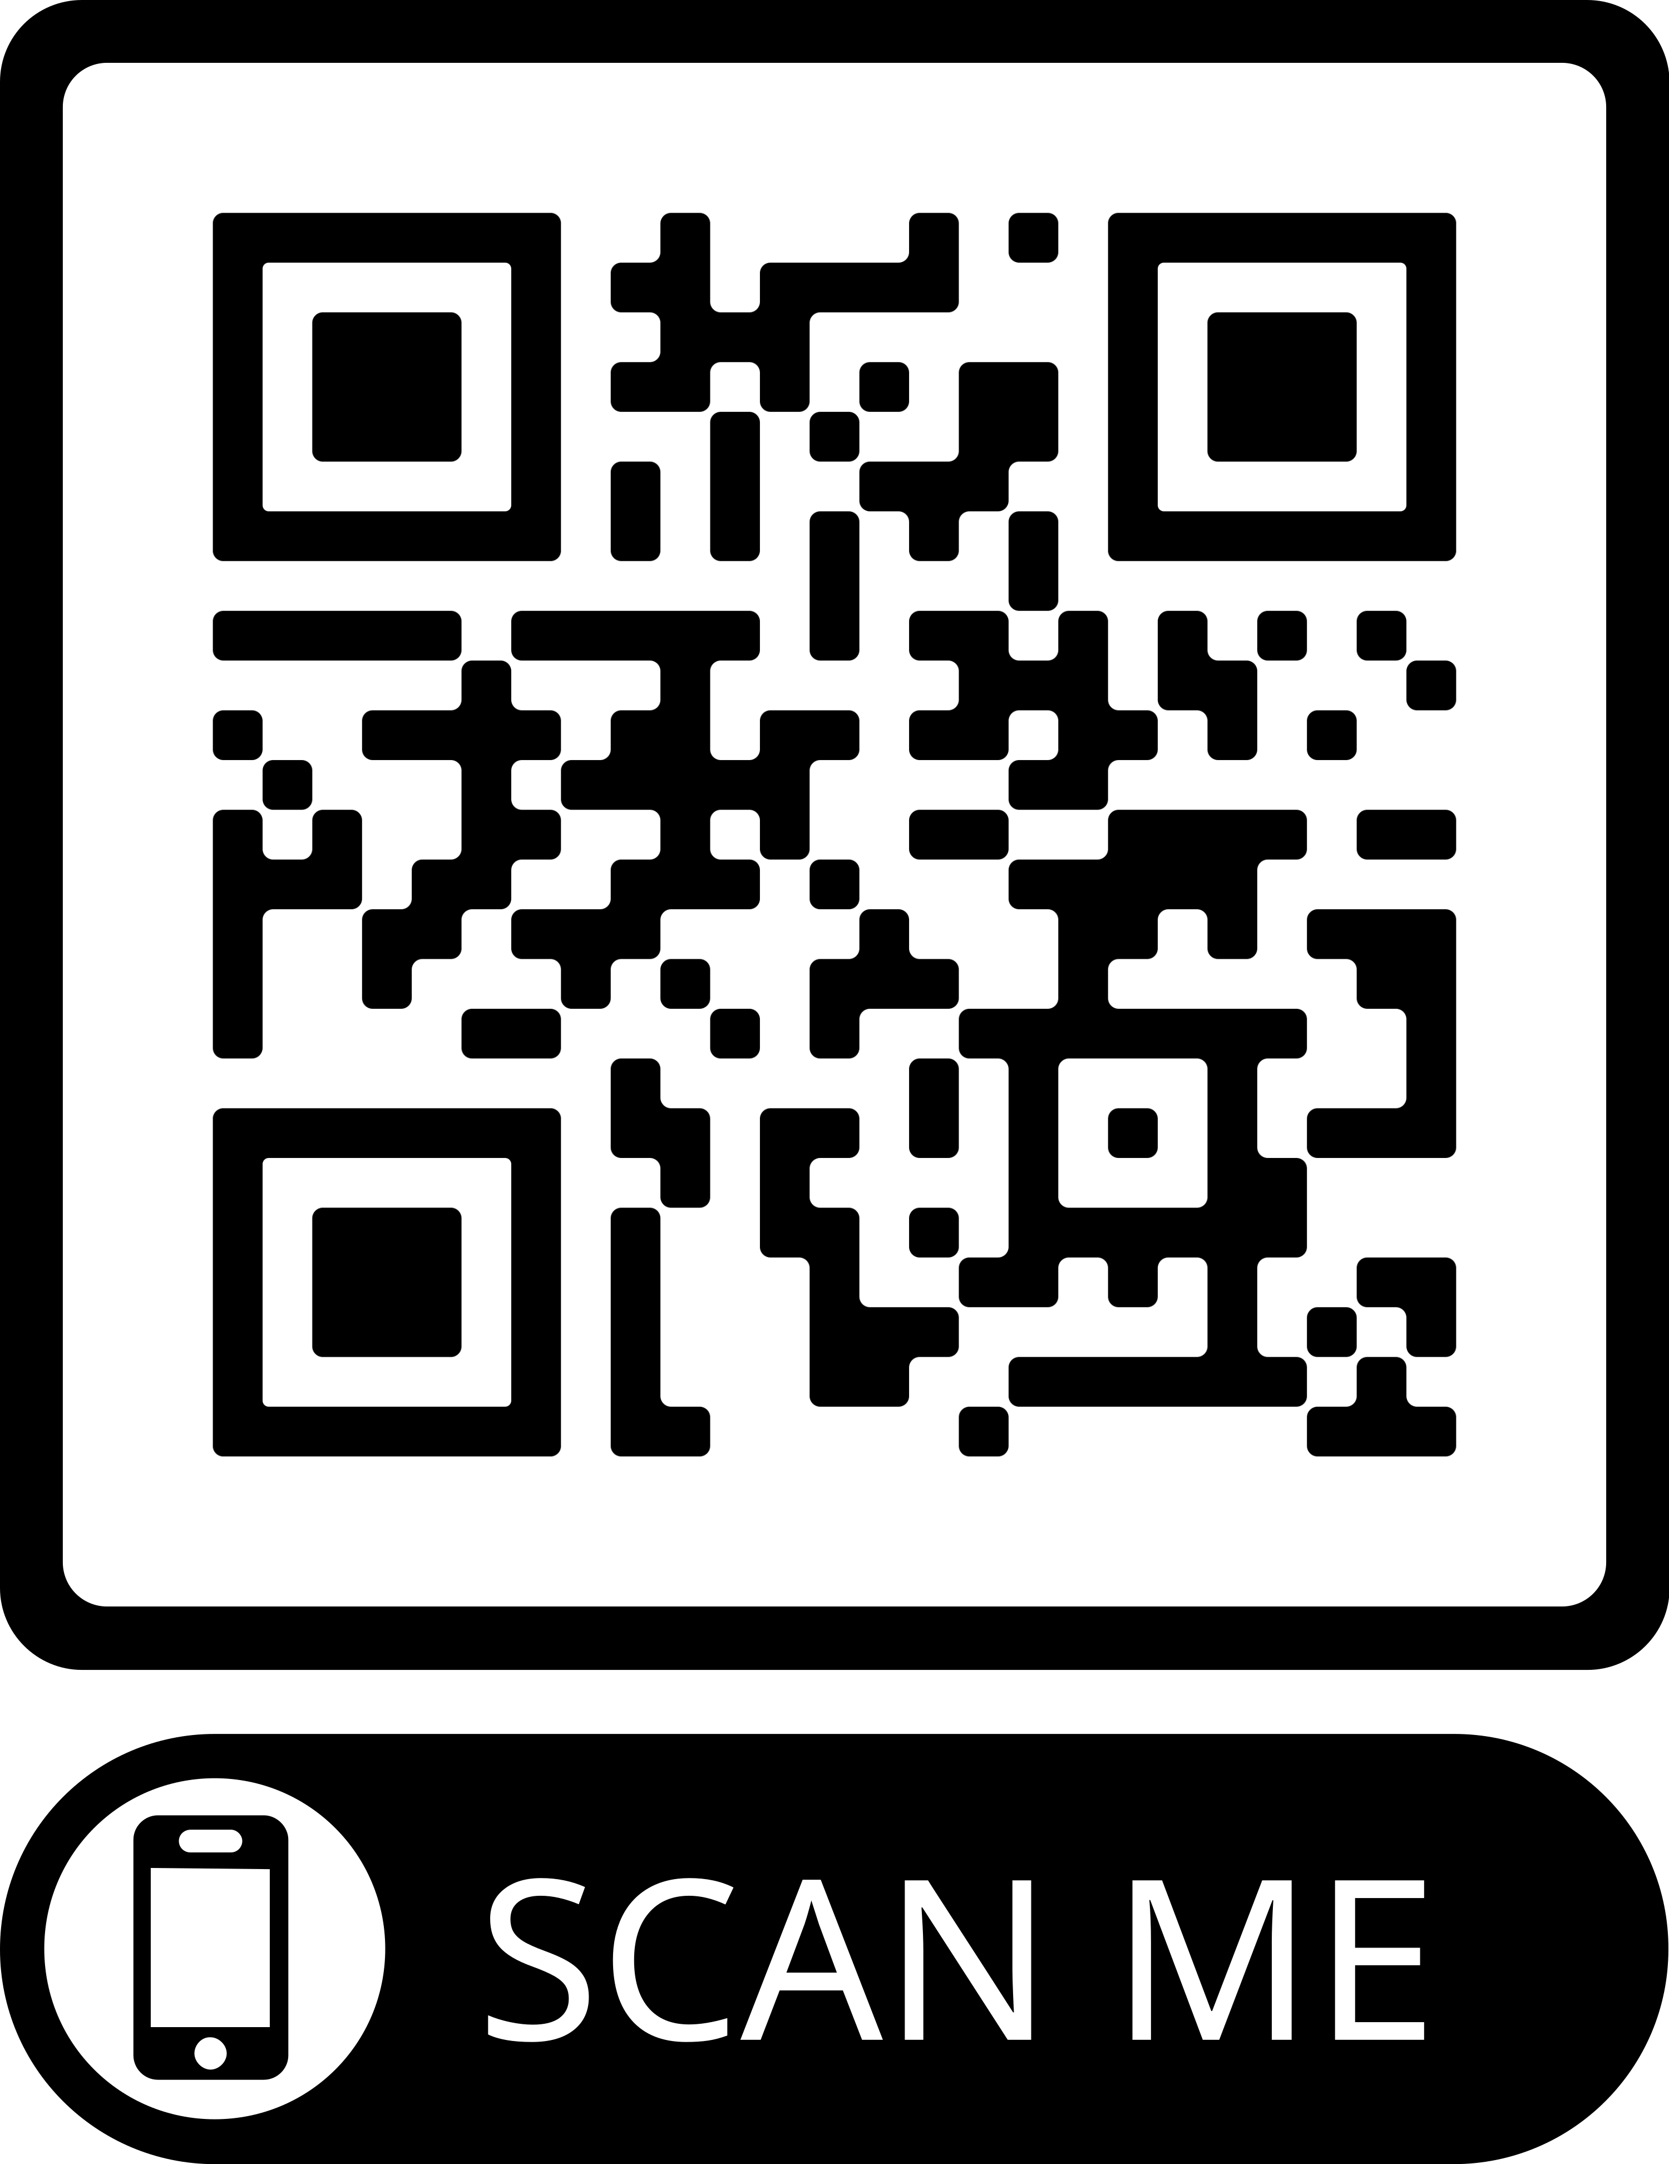
Interested in Participating in a Study on Moral Injury?
Email me to let me know: sgangemi@uccs.edu
or
QR code will take you to email sign up and you will be sent survey in the coming weeks.

Slide 37
THANK YOU! & Questions?
sgangemi@uccs.edu

Slide 38
References
Aiyegbusi, A., & Tuck, G. (2008). Caring amid victims and perpetrators: Trauma and forensic mental health nursing. In J. Gordon & G. Kirtchuk (Eds.), Forensic psychotherapy monograph series. Psychic assaults and frightened clinicians: Countertransference in forensic settings (p. 11–26). Karnac Books.
Bain, P., Vaes, J., & Leyens, J. (2014). Humanness and dehumanization. NY: Psychology Press, Taylor and Francis.
Bandura, A. (1999). Moral Disengagement in the Perpetration of Inhumanities. Personality & Social Psychology
Dean, W., Talbot, S., & Dean, A. (2019). Reframing clinician distress: Moral injury not burnout. Federal Practitioner, 36(9), 400-402.
Farnsworth, J. (2019). Is and ought: Descriptive and prescriptive cognitions in military‐ related moral injury. Journal of Traumatic Stress, 32, 373–381.
Garland, B. (2002). Prison treatment staff burnout: consequences, causes and prevention. Corrections Today, 64(7), 116-121.
Gordon, J., & Kirtchuk, G. (2008). Psychic assaults and frightened clinicians: Countertransference in forensic settings. UK: Karnac.
Jinkerson, J. (2016). Defining and assessing moral injury: A syndrome perspective. Traumatology, 22(2), 122-130.

Slide 39
References cont’d
Lee, P. (2020). Moral Injury In Child Exploitation Investigators. Center for Research and Evidence on Security Threats. Lancaster University, Lancaster (UK).
Nash, W. (2019). Commentary on the Special Issue on Moral Injury: Unpacking Two Models for Understanding Moral Injury. Journal of Traumatic Stress, 32(3), 465– 470. https://doi.org/10.1002/jts.22409
Purcell N, Griffin BJ, Burkman K and Maguen S (2018) “Opening a Door to a New Life”: The Role of Forgiveness in Healing From Moral Injury. Front. Psychiatry 9:498. doi: 10.3389/fpsyt.2018.00498
Shay, J. (2014). Moral injury. Psychoanalytic Psychology, 31(2), 182-191.
Ross, Boston D., "Responding to Wounds of the Soul: American Law Enforcement, Moral Injury and Religious Coping" (2022). Doctoral Dissertations and Projects. 3656. https://digitalcommons.liberty.edu/doctoral/3656
Spinaris, C., Denhof, M., & Kellaway, J. (2012). Posttraumatic Stress Disorder in United States Corrections Professionals: Prevalence and Impact on Health and Functioning.

